Slide 1
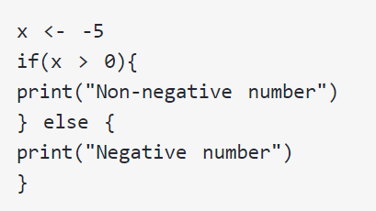
If else

Slide 2
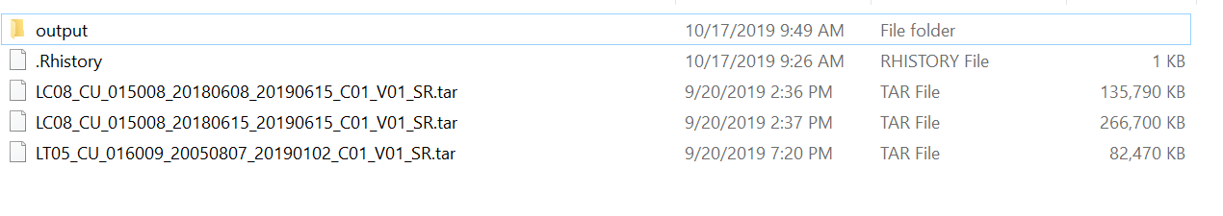
NDVI calculation for Landsat 5 and Landsat 8 (in-class)
For Landsat8 (LC08):
ndvi<-(band5-band4)/(band5+band4)
For Landsat5 (LT05):
ndvi<-(band4-band3)/(band4+band3)

Slide 3
Final project (15%) Presentation 5 points (~10 minutes for each group) Project report 10 points
 | Thanksgiving holiday
11/28 and 12/1 | Final project (presentation)
 | Final project (presentation)
Week15 12/5 | Final project (presentation)
Introduction
Methods
Results
Conclusion
5-7 pages double-space

Slide 4
Introduction
Why you wanted to do the project
What’s the need, what purpose might the data serve?
Materials & Methods
Study area and Data
Methods (e.g., spatial analysis, trend analysis, random forest for image classification, …)

Slide 5
Results & Discussion
Present figures and tables you create
Discuss their meaning
Conclusions
Summarize key findings
What did you learn from your project?

Slide 6
Land surface temperature analysis using R
Streamlining Geospatial Analysis for Watershed Modeling Using R
Retrieval and analyze population data using R
Assessing the Impact of Tropical Systems on Rainfall Totals in Hampton Roads, VA and the Outer Banks, NC from 1981 to 2020
Antarctic wetland image classification using Random Forest in R
Investigating roughness residuals in relation to vegetation heights
Landcover change and viewshed analysis on the Appalachian Trail in Pennsylvania
Using Random Forest Techniques and Drone Based Lidar to Predict Roughness in Floodplains
Deforestation Monitoring in Indonesia
Spatial Point Pattern Analysis of High Elevation Heath Barrens of West Virginia
Modelling 10 year Standardized Precipitation Index (SPI) change
Stream Discharge Prediction Model vs. Observed Values

Slide 7
Change Trend Analysis: Surface Temperature and Precipitation in Miami-Dade County & Miami, Florida
Extracting Geospatial Data via GPS Points for Black Bear Behavior & Foraging
Shark detection and spatiotemporal analysis from Instagram sightings
Changing streamflows in the Southern Appalachians
Flash Flood Risk Analysis – Data Processing in RStudio
Impact of forest fire on Reservoir Inflow in the United States of America
A Brief Look into the History of Climate Change
Batch watershed delineation and land cover extraction in R
Logistic Regression Model of Forest to Urban Change In Prince William County, VA

Slide 8
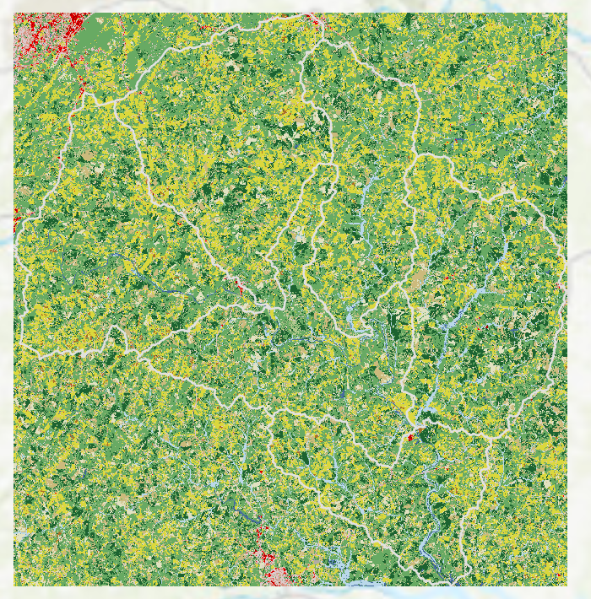
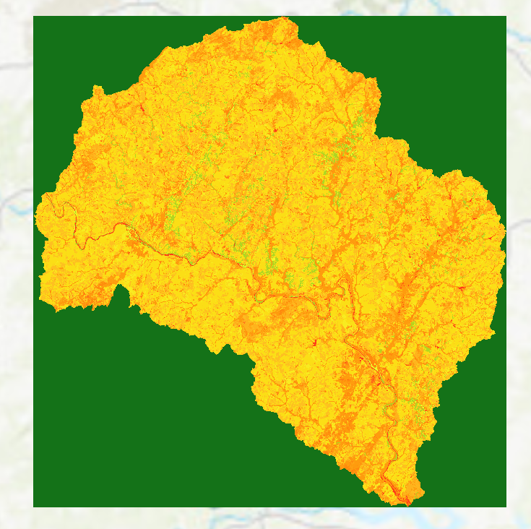
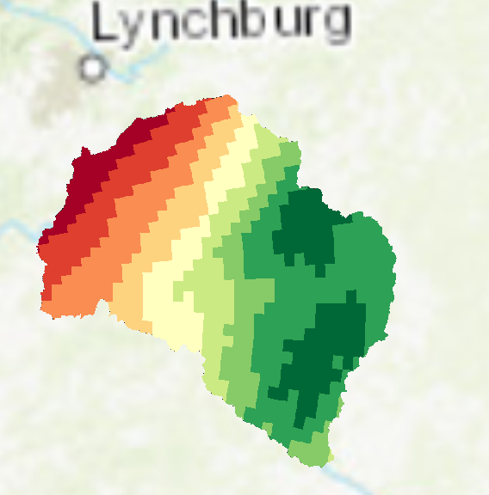
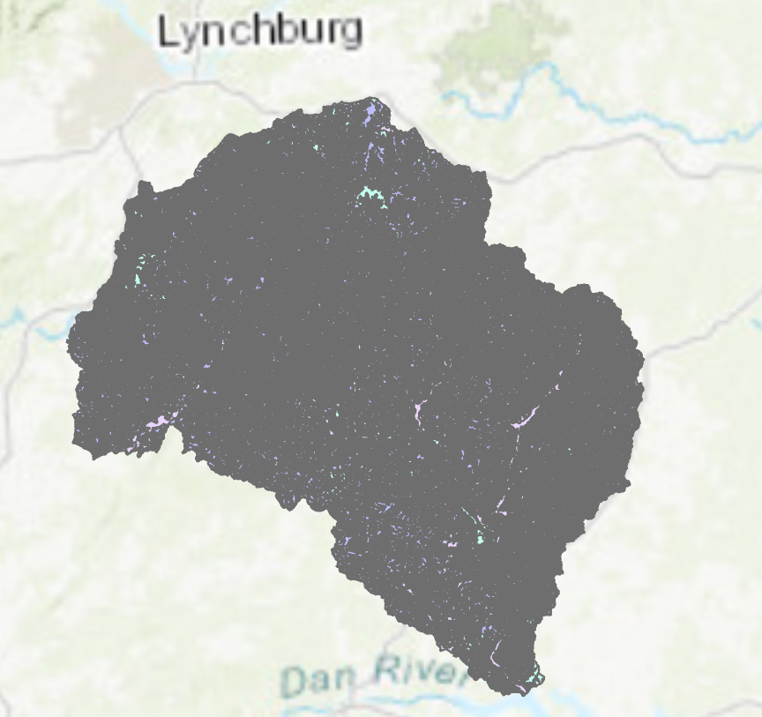
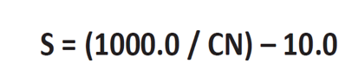
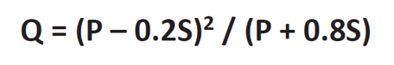
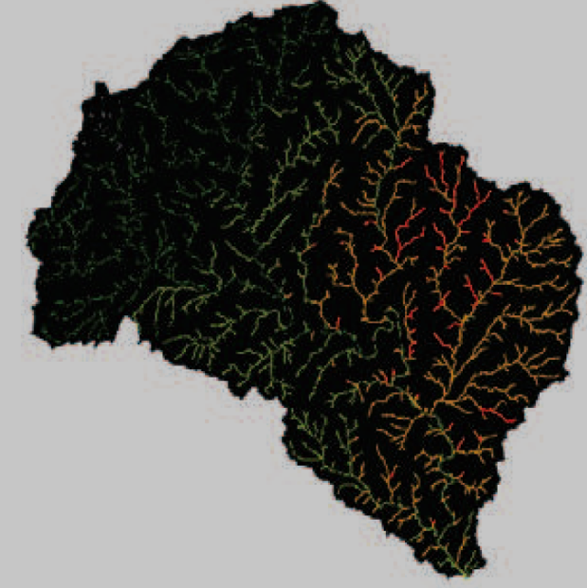
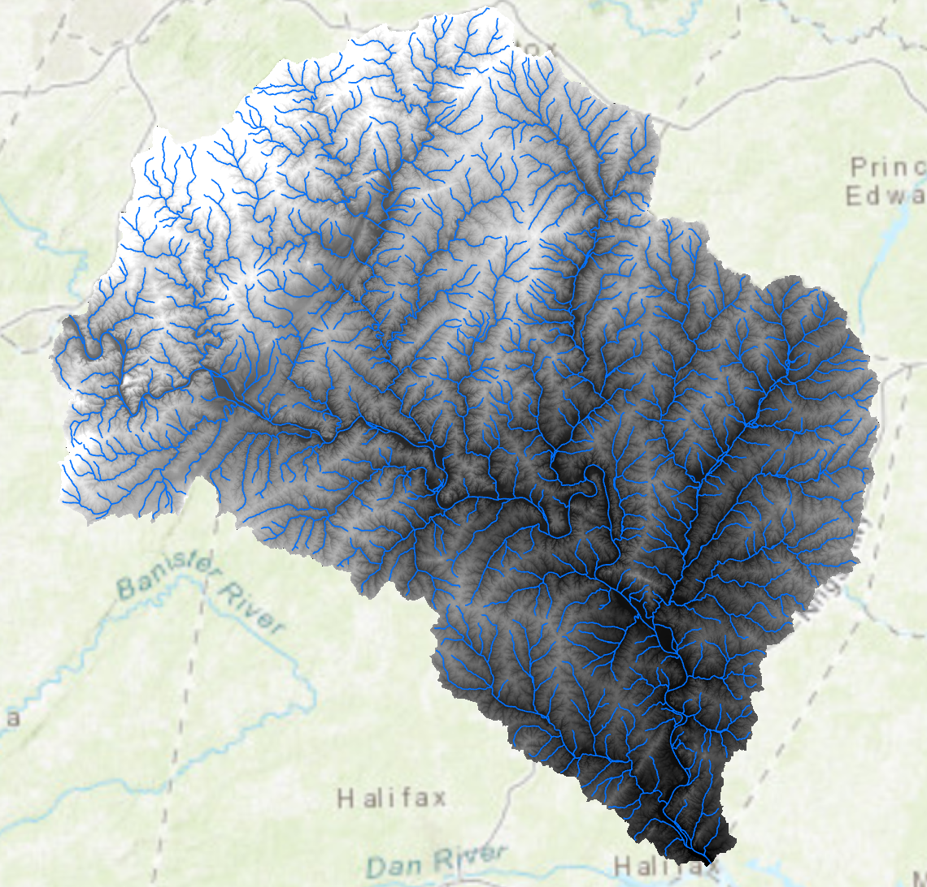
Raster Analysis: Flash Floods from Hurricane Matthew, Physical Processes & Spatial Numerical Models (GIS Modelling, G4084)
Curve Number layer
(the runoff properties)
Hurricane Matthew Rainfall (P)
Land cover (forest, urban, etc.)
Soil data (hydgrp A,B,C,D)
Runoff
Flow accumulation

Slide 9





Slides from previous semester’s presentation (BSE,VT)

Slide 10
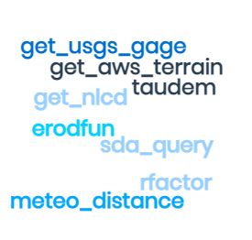
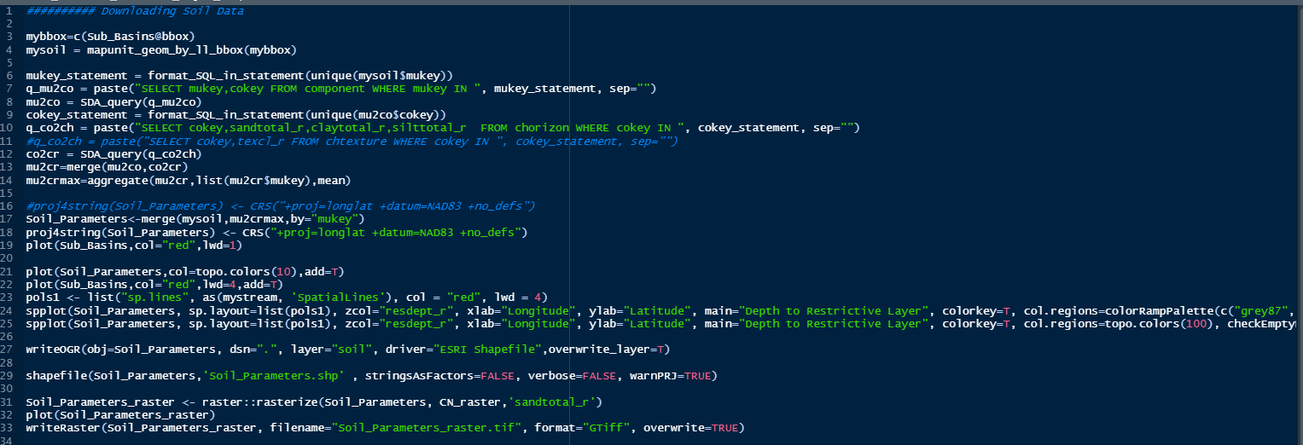
Retrieving Data from Federal Data Sources
Slides from previous semester’s presentation (BSE,VT)

Slide 11
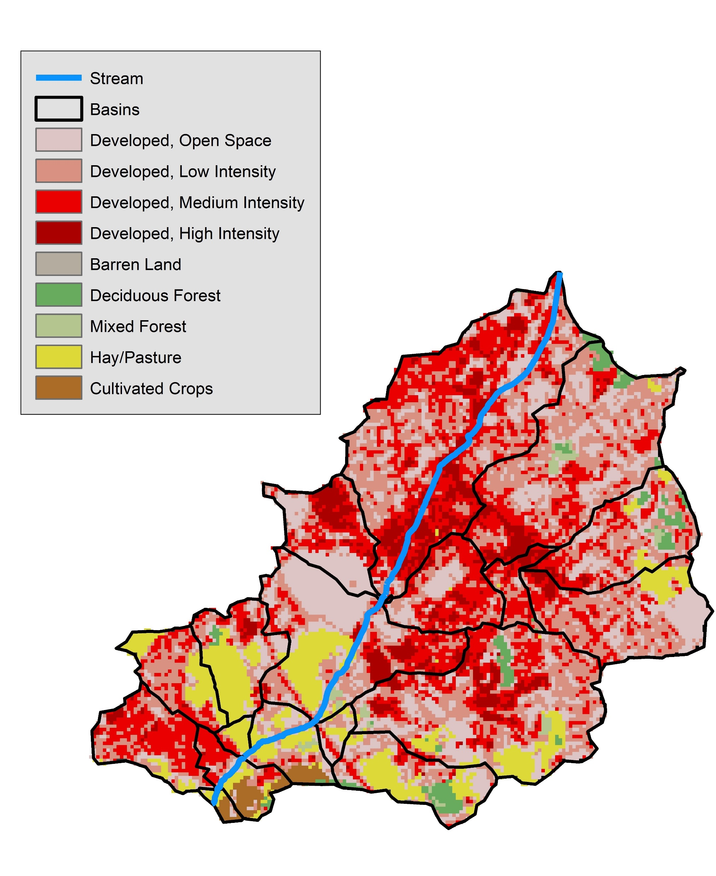
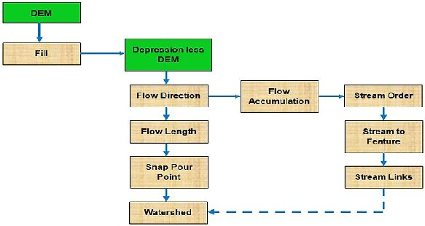
Watershed Delineation
Slides from previous semester’s presentation (BSE,VT)

Slide 12
Lab1(software, import raster and shapefile)
Lab2 (WUI mapping)
Lab3 (Forest fire)
Lab4 (Remote Sensing image classification)
Lab5 (Simulation of urban growth or ‘your lab’)
Lab6 (Time-series data)
Lab7 (Preparing geospatial data for watershed modeling)

